Slide 1
Broker Slides
Monthly Updates | September 2023

Slide 2
Product enhancements

Slide 3
Share My Listing widget changes allow easier sharing, browsing
SMyL 2.0 at a glance
Recent changes make it easier to browse listings and find what you need. Your listings will also be enhanced by better quality photos and more property detail views.
Here’s what’s new:
The sharing buttons are now under the three dots at the top-right of each photo.
The web views feature is now at the bottom-left of the property details page.
All virtual tour types are now available.
Check out the SMyL 2.0 updates in the Tools, Resources, & Links section of connectMLS or by visiting smyl.mredllc.com
Watch a training video
Request custom office training

Slide 4
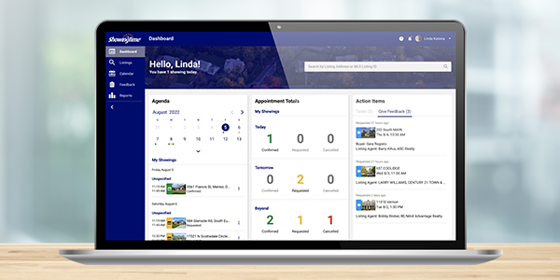
The Next Generation of ShowingTime is here!
Benefits of ShowingTime Next Generation include:
Enhanced buyer tour management
Offline mode
Multiple calendar views
Two-way calendar sync
Learn more about the upgrades
Try out this optional experience in four easy steps:
Log into ShowingTime as you normally would.
Tap or click the banner at the top of your screen.
You will be prompted to update your password or create a username and password if you typically access ShowingTime through your MLS.
You’re on your way!
See Quick Start Guide
Request ShowingTime training from MRED for your office

Slide 5
Realist is returning! Powerful property intelligence for MRED subscribers
Brokers asked for it, MRED is delivering public records data resource
Realist will seamlessly integrate with MRED’s existing MLS platforms.
MRED brought back Realist based on subscriber feedback. MRED users will be able to access Realist in Fall 2023.
Realist joins Remine, an existing property intelligence service offered by MRED.
Realist offers:
Advanced searching, mapping and reporting.
A live Automated Valuation Model feature called RealAVM.
Prospecting tools including the ability to print mailing labels and manage mail merge data.
A multitude of other data including flood and seismic maps, owners’ sales and transfer histories and tax and mortgage information.
A sell score which assesses the likelihood a property will be listed in the next six months.

Slide 6
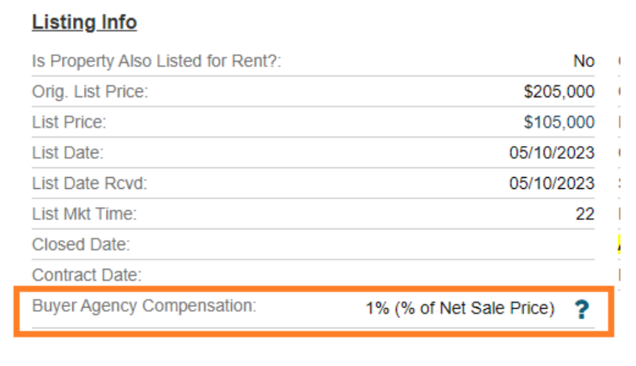
Buyer Agency Compensation added to Detail Client Report
In order to increase transparency, buyer’s agency compensation now appears in client-facing locations.
Buyer agency compensation is now displayed at the following locations:
Detail Client Reports
Client print-outs
connectMLS Client Portal
See how it looks

Slide 7
Answers to FAQs

Slide 8
Frequently asked questions
Q
What’s the difference between a Private listing and an Exempt listing?

Slide 9
Frequently asked questions
Q
What’s the difference between a Private listing and an Exempt listing?
A
Exempt listings are permitted to be fully excluded from the MLS at the direction of the seller and may not be publicly marketed. Private listings are mini drafts of property information that are being pre-marketed to MRED subscribers and must be input into connectMLS within 24 hours of public advertising.

Slide 10
Frequently asked questions
Q
For Private listings, what’s the difference between the Anticipated Activation Date and the List Date?

Slide 11
Frequently asked questions
Q
For Private listings, what’s the difference between the Anticipated Activation Date and the List Date?
A
The Anticipated Activation Date is when the listing is anticipated to be transitioned from a Private listing to a Standard listing.
If the Private listing is being moved to Standard as new, the List Date should reflect the actual date the listing is transitioned. If the Private listing is being moved to Standard as closed or contingent, the List Date should match the date of the listing agreement.
NOTE: The Anticipated Activation Date does not automatically transition the listing to a Standard listing on that date.

Slide 12
Frequently asked questions
Q
How do you search for Detached Single and Attached Single listings at the same time?

Slide 13
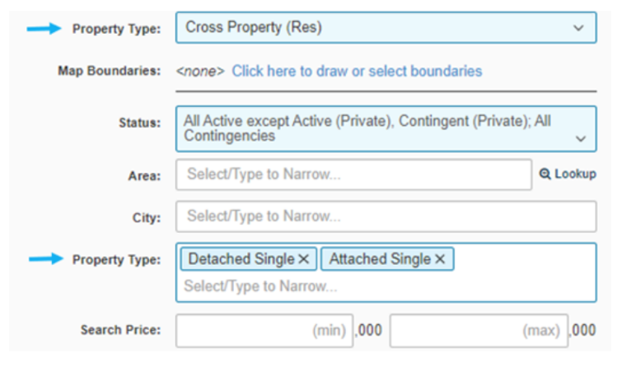
Frequently asked questions
Q
How do you search for Detached Single and Attached Single listings at the same time?
A
When beginning your search, select the property type “Cross-Property (Res)” to search multiple residential property types at once.
You can narrow it down to the specific residential property types you’d like to include by using the second property type field located further down on the search page.

Slide 14
Frequently asked questions
Q
What do I do if my listing photos aren’t uploading in connectMLS?

Slide 15
Frequently asked questions
Q
What do I do if my listing photos aren’t uploading in connectMLS?
A
You can upload up to 50 photos at a time, but we recommend uploading in smaller quantities to prevent slowness and freezing. If that doesn’t solve the issue, we recommend these steps:
Check the photos’ dimensions and file sizes. Large photos will take longer to upload and could result in upload failure.
Our recommended photo size is 1920 x 1080 pixels. You may upload photos up to 3840 x 2160; they will be resized to the recommended dimensions.
Make sure the photos are a supported file type. For best quality, use JPEG formats. Other formats such as PNG, GIF, BMP and TIFF are acceptable, but will automatically be converted and resized. (PDF and HEIC files are not accepted)
Clear your browser’s cache.

Slide 16
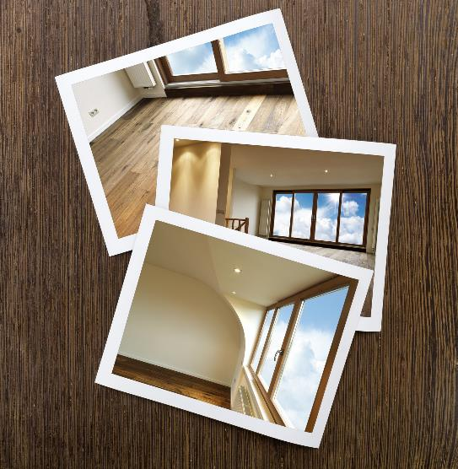
Frequently asked questions
Q
Do residential rentals have to have a primary photo of the building?

Slide 17
Frequently asked questions
Q
Do residential rentals have to have a primary photo of the building?
A
Yes. Residential rental listings must have a primary photo of the building.
Section 6.1.1 of MRED’s Rules and Regulations states: All listings except vacant land, new construction, confidential commercial listings, private listings and deeded parking/boat slips must have a primary photo in the system within 7 days of their entry into the system.

Slide 18
Frequently asked questions
Q
Can I list a tear down property in land and detached?

Slide 19
Frequently asked questions
Q
Can I list a tear down property in land and detached?
A
Yes. Tear-down properties may be placed in both property type Detached Single Family and property type Land. The sale may only be reported on one of the properties, and the other must be marked as cancelled or expired.

Slide 20
Education and resources

Slide 21
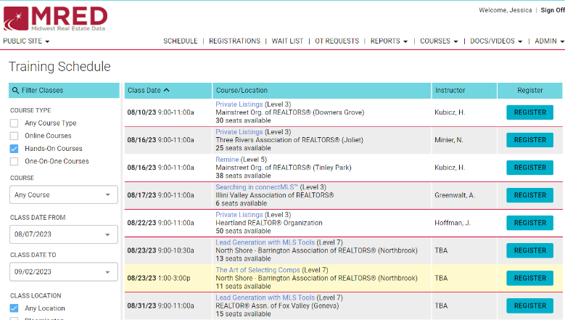
Do you miss in-person training?
Do you miss networking in person? Do you want to learn from MLS experts with real industry experience? MRED has in person training classes near you!
Join us by registering FOR FREE for our upcoming training classes! https://training.mredllc.com/schedule
Just filter “hands on” and “one on one.”

Slide 22
Need help with something else?
We have answers and options
Get answers to common questions 24/7 in the Knowledge Base.
Or Contact the Help Desk:
630-955-2755
help.desk@MREDLLC.com
Help Desk hours:
M-F: 8 a.m.- 6 p.m.
Sat: 9 a.m.-3 p.m.
Sun emergency: 10 a.m. – 2 p.m.
Contact Rules and Regulations
630-799-1471
rules.regs@MREDLLC.com
Request a meeting with our Broker Outreach team to have all your questions answered and get connected to the resources you need.
Sign up for training on MRED products and services. Visit training.mredllc.com.

Slide 23
Thank You
mredllc.com

