Slide 1
Broker Slides
Monthly Updates | August 2023

Slide 2
Product enhancements

Slide 3
Realist returns! Powerful property intelligence for MRED subscribers
Realist, the popular public records database from CoreLogic, is returning to MRED!
Realist will seamlessly integrate with MRED’s existing MLS platforms, allowing users to combine MLS and other real estate data into one property intelligence resource.
MRED brought back Realist based on subscriber feedback. MRED users will be able to access Realist in Fall 2023.
Realist joins Remine, an existing property intelligence service offered by MRED.

Slide 4
Realist returns! Powerful property intelligence for MRED subscribers
Realist offers:
Advanced searching, mapping and reporting.
A live Automated Valuation Model feature called RealAVM.
Prospecting tools including the ability to print mailing labels and manage mail merge data.
A multitude of other data including flood and seismic maps, owners sales and transfer histories and tax and mortgage information.
A sell score which assesses the likelihood a property will be listed in the next six months.

Slide 5
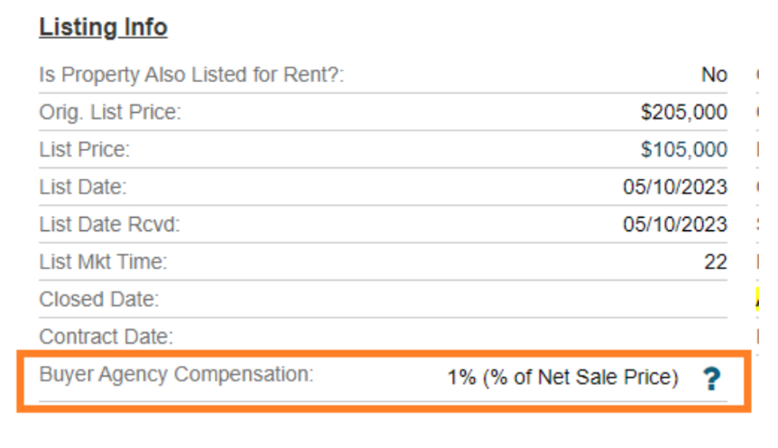
Buyer Agency Compensation added to Detail Client Report
In order to increase transparency and comply with NAR guidelines, buyer’s agency compensation now appears in client-facing locations.
Buyer agency compensation is now displayed at the following locations:
Detail Client Reports
Client print-outs
connectMLS Client Portal
See how it looks

Slide 6
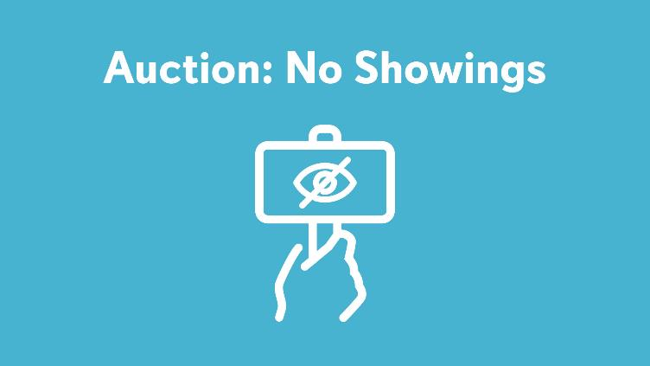
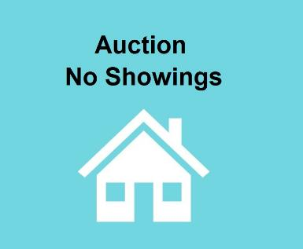
connectMLS update: auction properties can be marked as not available for showings
AUCT (Auction) properties can now be marked as “not available for showings” and remain in Auction status.
If a property is marked as AUCT (Auction) and the selection for showings is “no,” a photo place card reflecting the status will automatically be attached to the listing.
This will allow AUCT properties that aren’t able to be shown to continue to appear on third-party websites, providing additional exposure and transparency for the listing.
This change was suggested by MRED subscribers and approved by the Board of Managers.

Slide 7
Coming soon: connectMLS mobile app
connectMLS is getting a mobile app this year!
Once it arrives, you’ll be able to download this time-saving tool to your smartphone or tablet to access these important features:
Add/edit capabilities
Ability to stay logged in
Faster navigation
Better-looking market reports and forms

Slide 8
Answers to FAQs

Slide 9
Frequently asked questions
Q
How can I add a custom document under the Documents tab for a listing?

Slide 10
Frequently asked questions
Q
How can I add a custom document under the Documents tab for a listing?
A
Go to Listings > View/Manage My Listings & Transactions
For active listings, click the MLS number for the listing, and click on the Documents tab across the top
For draft listings, click the Edit Pencil for the listing and click on the Documents tab on the left-hand side of the listing details.
Under the Documents tab, click on + Add Document. Choose the file, then for Document Type, click on “Other-Public”. Customize the Document Name to describe the file being uploaded. Click Add to add the document to the listing
Tip: When facing issues with document uploads, double-check the file name of the document. If the file name is too long, the upload may not go through successfully. To fix this, shorten the file name and try uploading again.
Accepted file types are PDF, Word, Excel and common photo formats

Slide 11
Frequently asked questions
Q
What are the benefits of using the “Full-Agent (Optimized)” report for listings?

Slide 12
Frequently asked questions
Q
What are the benefits of using the “Full-Agent (Optimized)” report for listings?
A
This report is ideal for mobile devices, as it fits to the screen of the mobile device, making scrolling and viewing listing information a breeze.
If an open house is scheduled for a listing, it will display directly on the listing report beneath the photo of the property!
The look of the optimized report is more open, spacious, and modern compared to the classic report.
To change your default report to the Full-Agent (Optimized) report, visit your connectMLS Settings, and click “Search & Report Defaults”. Using the “Detailed Report” drop-down, select Full-Agent (Optimized).

Slide 13
Frequently asked questions
Q
What information must be included for listings with deeded parking?

Slide 14
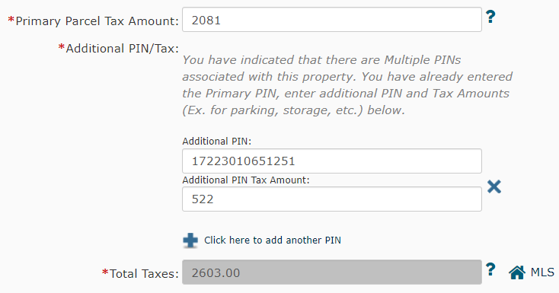
Frequently asked questions
Q
What information must be included for listings with deeded parking?
A
Three requirements must be met if deeded parking is included in your listing’s sale price:
The multiple PIN field must reflect “yes”
The additional PIN number must be included
The additional tax amount must be input.

Slide 15
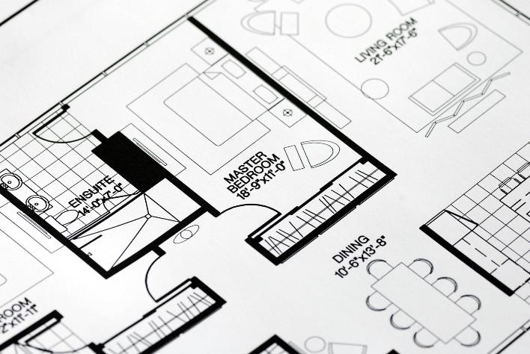
Frequently asked questions
Q
Does a room have to have a closet for it to be considered a bedroom?

Slide 16
Frequently asked questions
Q
Does a room have to have a closet for it to be considered a bedroom?
A
No. A room without a closet can be counted as a bedroom.
A bedroom is defined as a private room closed off from other living space, which does not have its only entrance from another bedroom.
This definition will meet appraiser standards for bedrooms and would exclude tandem rooms.

Slide 17
Education and resources

Slide 18
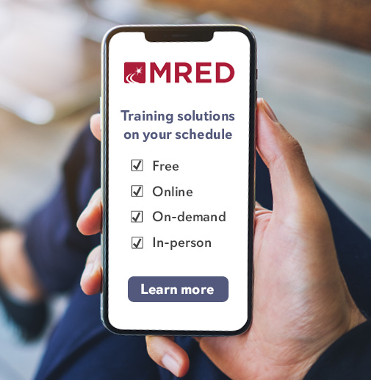
Did you know MRED training is FREE?
It’s also available on-demand and in-person!
See the upcoming training schedule
Watch on-demand training videos

Slide 19
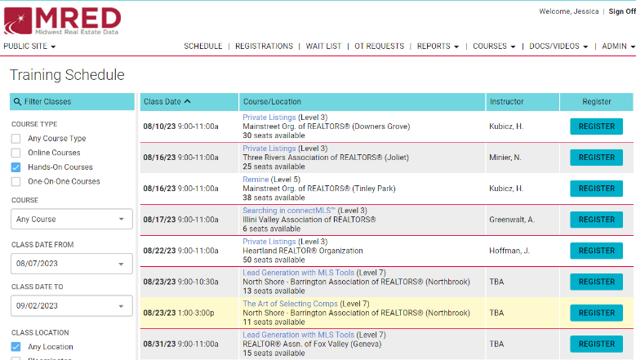
Do you miss in-person training?
Do you miss networking in person? Do you want to learn from MLS experts with real industry experience? MRED has in person training classes near you!
Join us by registering FOR FREE for our upcoming training classes! https://training.mredllc.com/schedule
Just filter “hands on” and “one on one.”

Slide 20
Need help with something else?
We have answers and options
Get answers to common questions 24/7 in the Knowledge Base.
Or Contact the Help Desk:
630-955-2755
help.desk@MREDLLC.com
Help Desk hours:
M-F: 8 a.m.- 6 p.m.
Sat: 9 a.m.-3 p.m.
Sun emergency: 10 a.m. – 2 p.m.
Contact Rules and Regulations
630-799-1471
rules.regs@MREDLLC.com
Request a meeting with our Broker Outreach team to have all your questions answered and get connected to the resources you need.
Sign up for training on MRED products and services. Visit training.mredllc.com.

Slide 21
Thank You
mredllc.com

