Slide 1
Broker Slides
Monthly Updates | July 2023

Slide 2
Product enhancements

Slide 3
Coming soon: connectMLS mobile app
connectMLS is getting a mobile app this year!
Download this time-saving tool to your smartphone or tablet to access these important features:
Add/edit capabilities
Ability to stay logged in
Faster navigation
Better-looking market reports and forms

Slide 4
RatePlug: Give your buyers information on special finance options
Rising interest rates and low home inventories have pushed buyers out of the market because they are unsure if they can afford the housing payment. RatePlug, a tool built directly into the MLS, lets you share accurate monthly home payment estimates for multiple mortgage products including zero- and low-down payment options from trusted lenders.
No additional cost for MRED subscribers*
Displays ONLY your trusted lending sources.
Interactive, real-time mortgage information.
Notifies you of special financing options (FHA, VA, USDA, etc.).
Includes digital and printable property flyer program.
Help your buyers go from “can I afford that?” to “I CAN AFFORD THAT!”
*lenders pay a license fee to be displayed on listings and flyers.
Activate your free Rateplug account

Slide 5
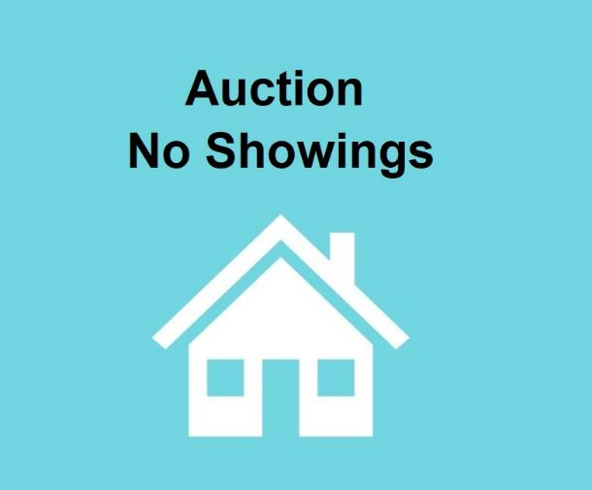
connectMLS update: auction properties can be marked as not available for showings
Effective immediately, AUCT (Auction) properties can be marked as “not available for showings” and remain in Auction status.
If a property is marked as AUCT (Auction) and the selection for showings is “no,” a photo place card reflecting the status will automatically be attached to the listing.
This will allow AUCT properties that aren’t able to be shown to continue to appear on third-party websites, providing additional exposure for the listing.
This change was suggested by MRED subscribers and approved by the Board of Managers.

Slide 6
Answers to FAQs

Slide 7
Frequently asked questions
Q
Can supplemental photos be removed from an off-market listing at the request of the seller?

Slide 8
Frequently asked questions
Q
Can supplemental photos be removed from an off-market listing at the request of the seller?
A
No. MRED’s Rules and Regulations state the only reasons photos may be removed from a listing are:
• To reflect a change in seasons
• To reflect improvements to the home.
• To substitute a higher-quality version of the same image
Listing Brokers may choose to have an off-market listing’s secondary photos (but not primary photos) suppressed from third-party sites. This can be done by clicking “Exclude from Consumer Websites when off-market” on the desired photos.
When in doubt, email rules.regs@mredllc.com.

Slide 9
Frequently asked questions
Q
How do I calculate the lease price on my commercial listing?

Slide 10
Frequently asked questions
Q
How do I calculate the lease price on my commercial listing?
A
For commercial properties only, it is the yearly rent divided by the square footage available.
For example: If a 5,000 square foot unit rents for $1,500 a month, the correct entry in this field would be $3.60.
($1,500 x 12 = $18,000 ÷ 5,000 = $3.60)

Slide 11
Frequently asked questions
Q
How do I receive credit for a non-MLS transaction (FSBO, etc.)?

Slide 12
Frequently asked questions
Q
How do I receive credit for a non-MLS transaction (FSBO, etc.)?
A
To receive credit for a non-MLS transaction, go to Listings > Add New Listing. Select “Comp Sold Outside MLS” for the Property Type.
This transaction will be added to your total transaction volume and will be found in your transaction manager after you publish it.
Note: Outside comps are not searchable and do not syndicate to any third-party tools or services.
Learn more about outside comps

Slide 13
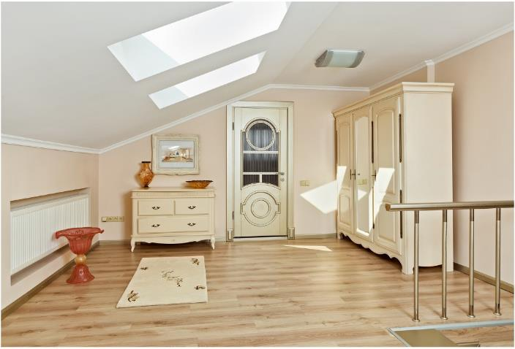
Frequently asked questions
Q
The property I am listing has a loft that can easily be converted to a bedroom. Can I include that in the bedroom count?

Slide 14
Frequently asked questions
Q
The property I am listing has a loft that can easily be converted to a bedroom. Can I include that in the bedroom count?
A
No, you must list the property how it currently is, not how it could be with renovations.

Slide 15
Education and resources

Slide 16
New MRED training class now available
Navigating the Do’s and Don’ts of MLS Rules
Accurate listing data is vital for a multiple listing service. This class covers the major areas of compliance and will help you save time and ensure good data entry.
From how rules are made, to the importance of entering listings accurately the first time to save the extra work of data re-entry, this course will set you on the path to success in maintaining clean and reliable listing data.
Search for online training
Search for in-person training

Slide 17
New MRED training class now available
Private Listing training class
Are your agents still looking for clarification on MRED Rules or updates to Private Listings? These are the classes for you!
In Person: Private Listings
In Person: Navigating the do's and don't of MLS rules
Live Online: Private Listings
Live Online: Navigating the do's and don't of MLS rules
Search for online training
Search for in-person training

Slide 18
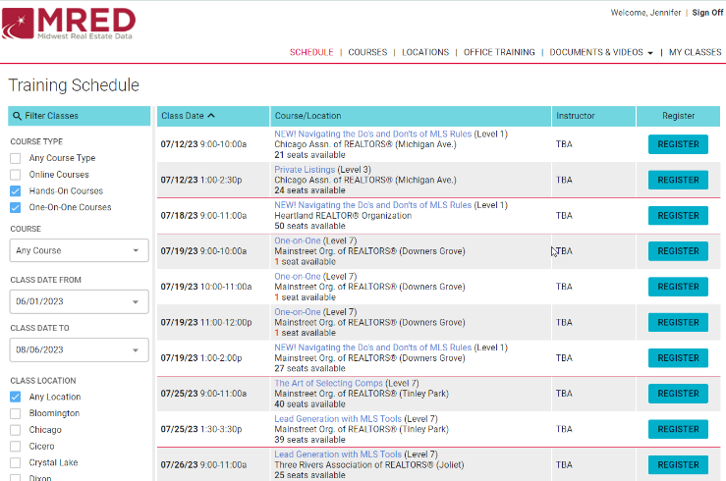
Do you miss in-person training?
Do you miss networking in person? Do you want to learn from MLS experts with real industry experience? MRED has in person training classes near you!
Join us by registering FOR FREE for our upcoming training classes! https://training.mredllc.com/schedule
Just filter “hands on” and “one on one.”

Slide 19
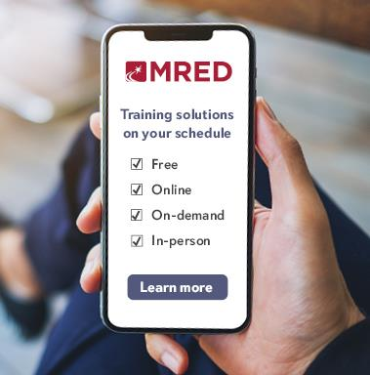
Did you know MRED training is FREE?
It’s also available on-demand and in-person!
See the upcoming training schedule
Watch on-demand training videos

Slide 20
Need help with something else?
We have answers and options
Get answers to common questions 24/7 in the Knowledge Base.
Or Contact the Help Desk:
630-955-2755
help.desk@MREDLLC.com
Help Desk hours:
M-F: 8 a.m.- 6 p.m.
Sat: 9 a.m.-3 p.m.
Sun emergency: 10 a.m. – 2 p.m.
Contact Rules and Regulations
630-799-1471
rules.regs@MREDLLC.com
Request a meeting with our Broker Outreach team to have all your questions answered and get connected to the resources you need.
Sign up for training on MRED products and services. Visit training.mredllc.com.

Slide 21
Thank You
mredllc.com

