Slide 1
Broker Slides
Monthly Updates | June 2023

Slide 2
Product enhancements

Slide 3
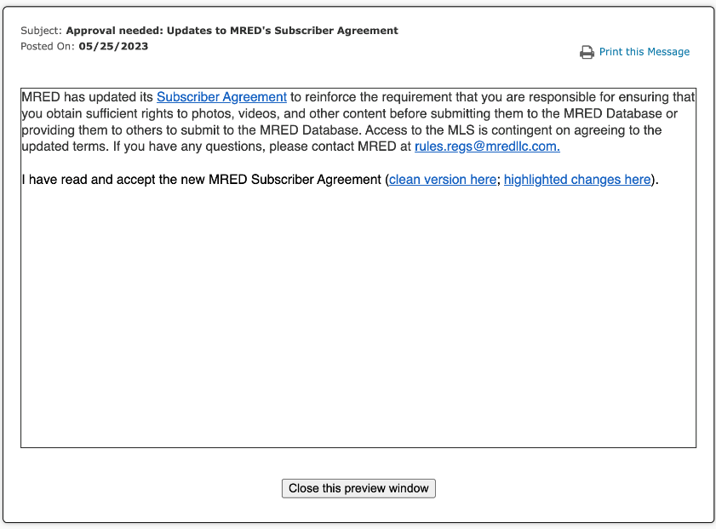
Approval needed: Updates to MRED’s Participant/ Subscriber Agreements
MRED has updated its Subscriber and Participant agreements to reinforce the requirement that you are responsible for ensuring that you obtain sufficient rights to photos, videos, and other content before submitting them to the MRED Database or providing them to others to submit to the MRED Database.
Access to the MLS is contingent on agreeing to the updated terms. If you have any questions, please contact MRED at rules.regs@mredllc.com.
Click here to read the Participant FAQs
Click here to read the Subscriber FAQs

Slide 4
Quickly deliver saved search results to your clients
Use real-time search in connectMLS
When saving an automatic search for your client, the Real-Time option is the quickest way to have listings sent.
After specifying your search criteria:
Click “Save Search”
Choose “Automatic Search”
Select “Real-Time”

Slide 5
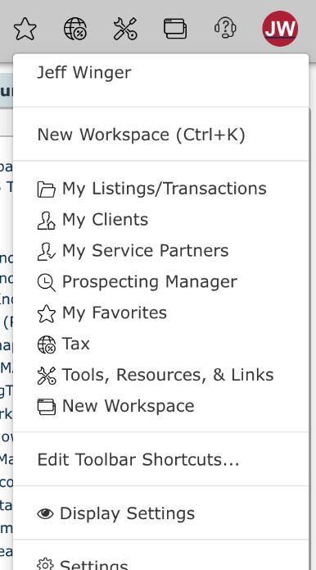
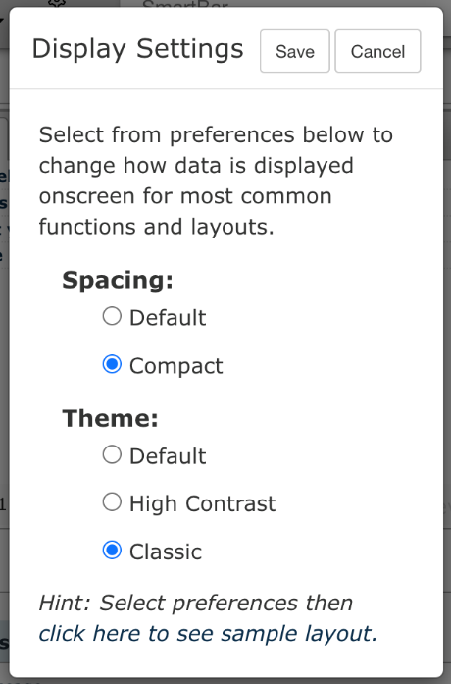
Customize your connectMLS view
Your dashboard – your way
Make connectMLS work better for you!
You can choose your connectMLS display preferences by clicking on your photo/initials at the top-right of connectMLS and selecting “Display Settings”.
To make your experience look more like the previous version of connectMLS:
Click on your initials/profile picture
Click "Display Settings”
Select "Compact" for your Spacing and "Classic" for your Theme.

Slide 6
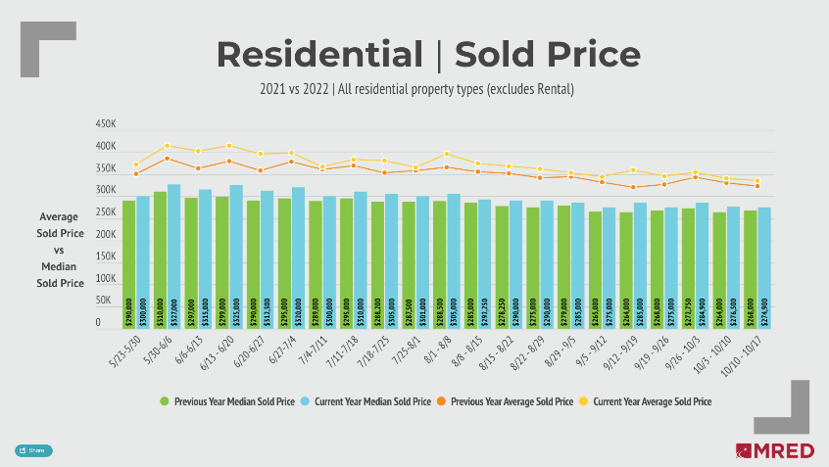
Stay on top of trends with MRED’s Weekly Market Snapshot
Each week, MRED sends out a report highlighting key marketplace metrics you can share with your clients!
This report includes the latest numbers on:
Closed listings
Listings under contract
New listings
Open houses
Median sales prices
Click the “Share” button on the report to post on social media or send a link to clients.
See the report

Slide 7
Answers to FAQs

Slide 8
Frequently asked questions
Q
How do I report a violation on a connectMLS listing?

Slide 9
Frequently asked questions
Q
How do I report a violation on a connectMLS listing?
A
You can anonymously report a violation of MRED rules on a connectMLS listing by going to the listing, clicking the circle-i additional information button and selecting "Report Violation Anonymously". If you use Classic Search in connectMLS, you can also find the “Report Violation Anonymously” link in the top-right corner of the listing.
Additionally, you can email the violation information to rules.regs@mredll.com.

Slide 10
Frequently asked questions
Q
When do Contingent listings appear as active on syndication websites?

Slide 11
Frequently asked questions
Q
When do Contingent listings appear as active on syndication websites?
A
In September of 2021 MRED made a change which would allow CTG (Contingent) listings to appear as ACTV (Active) on syndicated sites that have “YES” for continue to show for any of the following flags.
HC24 - House to Close (24 Hr Kick-out)
HC48 - House to Close (48 Hr Kick-out)
HC72 - House to Close (72 Hr Kick-out)
HS24 - House to Sell (24 Hr Kick-out)
HS48 - House to Sell (48 Hr Kick-out)
HS72 - House to Sell (72 Hr Kick-out)
HS - House to Sell (Other Kick-out hours)
PS - Property to Sell
PC - Property to Close
The change was made to allow properties in these specific categories to obtain added market exposure. Many backup offers are accepted when properties are tied to these contingency flags.

Slide 12
Frequently asked questions
Q
Can brokerages’ offers of compensation be displayed via VOW and IDX feeds?

Slide 13
Frequently asked questions
Q
Can brokerages’ offers of compensation be displayed via VOW and IDX feeds?
A
MRED’s Board of Managers approved a policy change Oct. 14, 2021, to amend MRED Rule 32.20 to allow brokerages to display brokerages’ offers of compensation. MRED provides offers of compensation via VOW and IDX feeds.
The policy will provide additional transparency for consumers and brokers. Taking the additional steps of adding the compensation information and disclosure to the Client Search Portal and Clients Report will enhance transparency.

Slide 14
Frequently asked questions
Q
I have a written and accepted contract but do not have the earnest money yet. Do I have to change my listing to contingent/pending or can I wait for the earnest money?

Slide 15
Frequently asked questions
Q
I have a written and accepted contract but do not have the earnest money yet. Do I have to change my listing to contingent/pending or can I wait for the earnest money?
A
The status must be reported as CTG/PEND within 48 hours from the date of the last acceptance signature regardless of receiving earnest money.

Slide 16
Frequently asked questions
Q
What happens if the same broker continually misrepresents data on their listings?

Slide 17
Frequently asked questions
Q
What happens if the same broker continually misrepresents data on their listings?
A
If MRED becomes aware of repeated data misrepresentation by any subscriber, the following process will take place.
MRED RULES SECTION 9.17: REPEATED PATTERNS OF DATA MISREPRESENTATION
Notwithstanding the foregoing, should the Service become aware of repeated patterns of data misrepresentation by any customer:
1. The Service shall notify the customer, the managing broker, and the brokerage of the pattern of data misrepresentation.
2. MRED reserves the right to assess a $2,500 fine for each subsequent occurrence of data misrepresentation until a 12-month period without occurrences is established.
3. All fines otherwise indicated in these Rules & Regulations as correctable within a 72-hour period and fitting the repeated pattern of data misrepresentation shall convert to automatic fines.
4. All rights to appeal an assessed fine, as found in Section 9.2, and Sections 13-22, remain in effect.

Slide 18
Frequently asked questions
Q
Can clients search for properties on their own in connectMLS?

Slide 19
Frequently asked questions
Q
Can clients search for properties on their own in connectMLS?
A
Yes! Clients can search for properties if they are opted in to client portal 2.0.
To opt-in existing clients, go to "Clients", click on your client’s name, and click on the edit pencil next to the Client Information section. Choose “Modern 2.0” at the top, and “Save”.
To opt-in new clients, go to “Settings”, “Client Portal Defaults”, “Portal Type”, and select “Modern 2.0”.

Slide 20
Frequently asked questions
Q
How do I change an active listing’s expiration date?

Slide 21
Frequently asked questions
Q
How do I change an active listing’s expiration date?
A
Go to “Listings”, “Extend Expiration Date”, enter the MLS number for the listing, and click “Submit”. From here, you will be able to extend or shorten the expiration date.

Slide 22
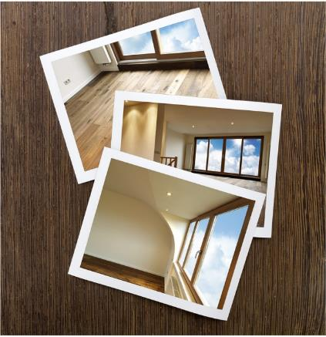
Frequently asked questions
Q
How do you prevent listing photos from appearing on public sites after the listing closes?

Slide 23
Frequently asked questions
Q
How do you prevent listing photos from appearing on public sites after the listing closes?
A
The list broker or an administrative member of the list office can exclude photos from public sites by following these steps:
Go to “Listings”, “Add/Edit Photos”
Enter the MLS number for the listing
Click “Submit”
Check the box "exclude from consumer sites when off-market” for each photo to be excluded
Click “Save Changes”
If the photos still appear after the listing has closed, email us at help.desk@mredllc.com for assistance.

Slide 24
Education and resources

Slide 25
New MRED training class now available
Navigating the Do’s and Don’ts of MLS Rules
Accurate listing data is vital for a multiple listing service. This class covers the major areas of compliance and will help you save time and ensure good data entry.
From how rules are made, to the importance of entering listings accurately the first time to save the extra work of data re-entry, this course will set you on the path to success in maintaining clean and reliable listing data.
Search for online training
Search for in-person training

Slide 26
Did you know MRED training is FREE?
It’s also available on-demand and in-person!
See the upcoming training schedule
Watch on-demand training videos

Slide 27
Need help with something else?
We have answers and options
Get answers to common questions 24/7 in the Knowledge Base.
Or Contact the Help Desk:
630-955-2755
help.desk@MREDLLC.com
Help Desk hours:
M-F: 8 a.m.- 6 p.m.
Sat: 9 a.m.-3 p.m.
Sun emergency: 10 a.m. – 2 p.m.
Contact Rules and Regulations
630-799-1471
rules.regs@MREDLLC.com
Request a meeting with our Broker Outreach team to have all your questions answered and get connected to the resources you need.
Sign up for training on MRED products and services. Visit training.mredllc.com.

Slide 28
Thank You
mredllc.com

