Slide 1
Broker Slides
Monthly Updates | May 2023

Slide 2
Product enhancements

Slide 3
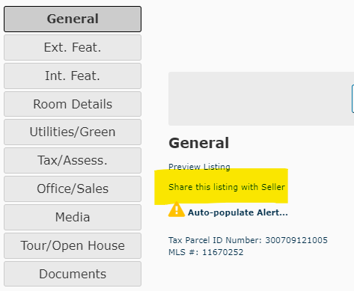
New: You can share draft listing previews with clients
Time-saving feature just added to connectMLS
When viewing a listing draft in connectMLS, you’ll now see this option: “Share this listing with Seller”.
Clicking this allows you to share the listing through connectMLS without needing to download it as a PDF.
This is helpful when obtaining seller approval for a listing before it goes live.
Click here to learn more

Slide 4
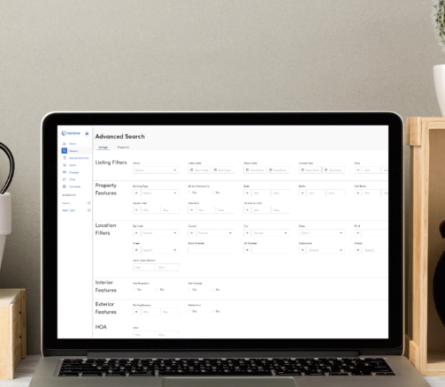
Are you getting the most out of your Remine searches?
Use your MLS-included Remine Pro access to search smarter
Save time and experience better searches with faster access to listing and tax information.
Need help navigating Remine? Click here to sign up for a Remine prospecting class or watch a recorded version of the webinar here.
Have questions? Contact MRED’s Help Desk at 630-955-2755 or help.desk@mredllc.com
Click here to learn more

Slide 5
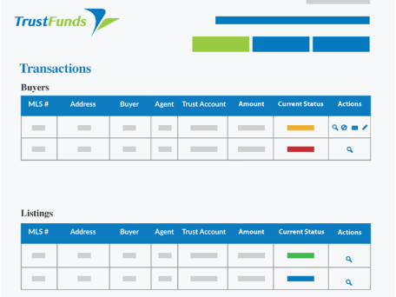
Are you using electronic earnest money in connectMLS?
TrustFunds adds security and convenience
Here’s why you’ll love using TrustFunds:
It’s more secure than a paper check.
It’s simple and convenient for you and your buyer.
You don’t have to spend time and money driving around to pick up checks.
You can see the real-time status of every payment request.
Learn more
Read the FAQs

Slide 6
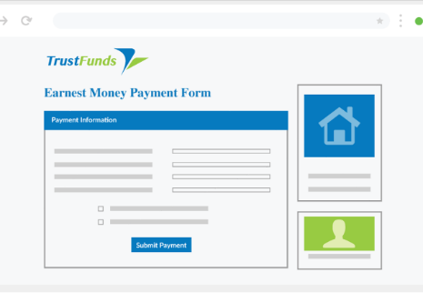
Getting started with electronic earnest money
Click the “Send Electronic Earnest Money” link under Additional Info on an active listing to get started. No need to log in or sign up!
Do you know a title company, attorney, or any other organization that’s part of receiving earnest money that you want on the list? Encourage them to sign up at this link so you can easily route earnest money to their account.
Questions? Contact the MRED Help Desk at 630-955-2755 or help.desk@mredllc.com.
Watch a how-to video
Get started in three steps

Slide 7
Text your MLS questions to MRED’s Help Desk
Our support teams are here to help!
Have an MLS question? MRED’s Help Desk team is here for you!
You’re now also just a text away from assistance! Text us at 630-955-2755 for help with quick questions.

Slide 8
Answers to FAQs

Slide 9
Frequently asked questions
Q
Are branded video tours allowed to be uploaded in connectMLS?

Slide 10
Frequently asked questions
Q
Are branded video tours allowed to be uploaded in connectMLS?
A
No. MRED rules prohibit the display of brokerage/agent-branded video tours in the virtual tour media fields.
NOTE: To comply with Illinois License Law, when uploading a non-branded tour to a video-sharing platform (YouTube, Vimeo, etc.), it must be set up as “unlisted” so it is not publicly searchable. Additionally, the username of the video-sharing platform must not be your name or company name.

Slide 11
Frequently asked questions
Q
Can I put company branding on the public documents I have uploaded to my listing under “Additional Information”?

Slide 12
Frequently asked questions
Q
Can I put company branding on the public documents I have uploaded to my listing under “Additional Information”?
A
No. Documents under the “Additional Information” tab on a listing may not contain company branding if they are viewable to the public. To upload branded documents, you must make them private to MRED subscribers only:
Go to “My Listings and Transactions”
Click on the desired listing number
Click on “Documents”
Click on the lock under “Security” and uncheck “Realtors’ Clients”
Branded documents may only be available to MRED subscribers and cannot be viewable by consumers.

Slide 13
Frequently asked questions
Q
How do I change a Private listing to a Standard listing?

Slide 14
Frequently asked questions
Q
How do I change a Private listing to a Standard listing?
A
Follow these steps:
Go to "My Listings/Transactions”
Click on the edit pencil for the desired property
Choose “Edit Listing Details/Change to Standard Listing”
Once you input the required Standard fields, click "Save and Change to Standard Listing” Once your listing passes MLS rules checks, you can choose to activate it as new or closed. If you are activating the listing as new, your list date should be today’s date.
If you are activating it as new to then change the status to contingent or pending, use the date on your original agreement. If you are activating it as closed, use the date on your original agreement.
If your listing is contingent or pending, you can mark it as such as either a Private or Standard listing.
Learn more

Slide 15
Frequently asked questions
Q
How do I search for distressed properties in connectMLS?

Slide 16
Frequently asked questions
Q
How do I search for distressed properties in connectMLS?
A
At the bottom of your search, click on Add/Remove Fields and add the field "Additional Sales Information”.
Once this field has been added to your search, you will be able to select options such as REO/Lender Owned, Short Sale, Pre-Foreclosure and Court Approval Required.
Note: Agents are not required to disclose a listing is an REO while it is active, so not all REO properties may appear in the search.

Slide 17
Frequently asked questions
Q
What’s the fastest way to deliver prospect search results to a client?

Slide 18
Frequently asked questions
Q
What’s the fastest way to deliver prospect search results to a client?
A
After entering the desired criteria for a prospect search, follow these steps:
Click “Save Search”
Select the desired client
Choose “Automatic Search”
Set the frequency as “Real-time”
Real-time searches will send results as they appear in connectMLS!
Note: A price range must be specified for real-time searches. Real-time searches work with active statuses only (ACTV, AUCT, BOMK, CTG, NEW, PCHG, RACT, TEMP, PRIV-ACTV, PRIV-CTG) and must include at least one location field (City, Area, Map Search, Zip Code, County, or School District).

Slide 19
Education and resources

Slide 20
New MRED training class now available
Navigating the Do’s and Don’ts of MLS Rules
Accurate listing data is vital for a multiple listing service. This class covers the major areas of compliance and will help you save time and ensure good data entry.
From how rules are made, to the importance of entering listings accurately the first time to save the extra work of data re-entry, this course will set you on the path to success in maintaining clean and reliable listing data.
Search for online training
Search for in-person training

Slide 21
Need help with something else?
We have answers and options
Get answers to common questions 24/7 in the Knowledge Base.
Or Contact the Help Desk:
630-955-2755
help.desk@MREDLLC.com
Help Desk hours:
M-F: 8 a.m.- 6 p.m.
Sat: 9 a.m.-3 p.m.
Sun emergency: 10 a.m. – 2 p.m.
Contact Rules and Regulations
630-799-1471
rules.regs@MREDLLC.com
Request a meeting with our Broker Outreach team to have all your questions answered and get connected to the resources you need.
Sign up for training on MRED products and services. Visit training.mredllc.com.

Slide 22
Thank You
mredllc.com

